Slide 1
Presented by Nafeesa Sanad S from
Aalim Muhammed Salegh College of Engineering.
This presentation explores the concept of the Smishing purpose is to be able to track SMS Phishing message with the Phishing Frenzy project. When a victim click on the link in the SMS, it will be tracked in Phishing Frenzy. Smishing will send SMS to the list of target.

Slide 2

Unveiling the Threat:
Exploring Phishing
Through Smishing

Slide 3

Introduction:
This presentation explores the threat of phishing through Smishing .We will delve into the tactics ,impacts,and prevention strategies of this cybercrime.stay informed and protect your identity.

Slide 4
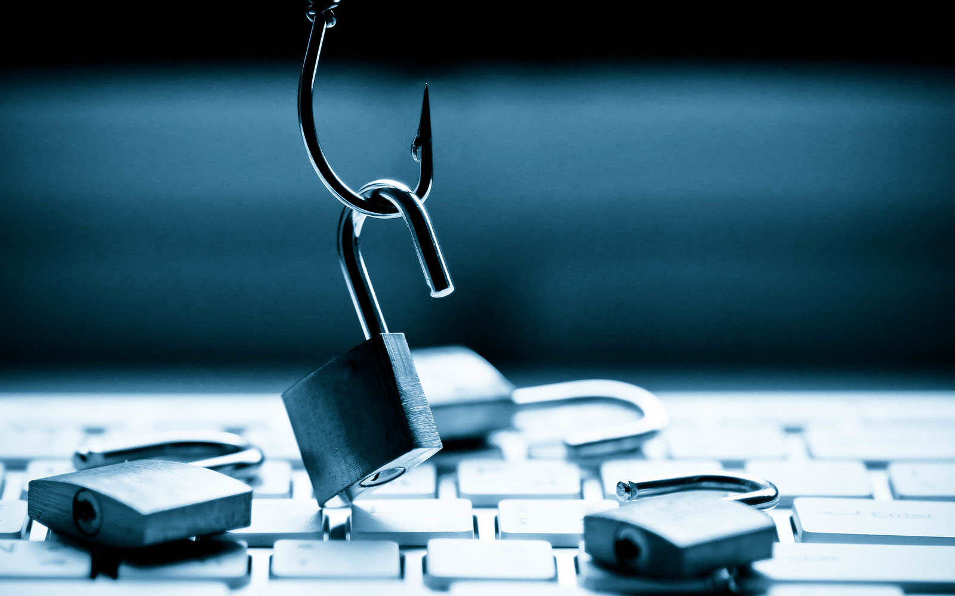
Understanding Phishing
Phishing is a fraudulent attempt to obtain
Sensitive information by disguising as a Trustworthy entity in electronic
communication. Emails, text messages,and phone calls are common mediums for
phishing attempts.

Slide 5
Exploring Smishing
Smishing is a form of phishing that uses text messages to
Deceive individuals into revealing personal information.
Attackers often use urgency or fear to manipulate victims
Into responding.

Slide 6

Phishers and Smishers use spoofed websites, fake login forms,
Malicious links to trick victims. They also employ Social engineering
To exploit human psychology and gain trust.
Tactics Used

Slide 7
Impacts of Phishing
Phishing and Smishing can lead to financial loss, identity theft,
Data breaches, and reputation damage for individuals and
Organizations. The consequences can be serve and
Long-lasting.

Slide 8

Implement multi-factor authentication, educate users about Phishing indicators, regularly update Security software, and encourage vigilance in recognizing suspicious communications.
Prevention Measures

Slide 9
Educating Users
Training and awareness programs are crucial in empowering individuals to identify and report Phishing attempts. Regularly remind users to verify sources before sharing sensitive information.

Slide 10

Estimating clear reporting procedures for suspected phishing attempts.
Encourage a culture of transparency and provide support for
Individuals who may have fallen victim to phishing.
Reporting Incidents

Slide 11

Staying Vigilant
Phishing and Smishing are constantly evolving.
It is essential to remain proactive and adaptive in combating these threats.
Continuous education and awareness are key.

Slide 12
Conclusion
In conclusion,understanding and addressing the threat
Of phishing through smishing is crucial for safeguarding
Personal and organizational security. Stay informed,stay vilgiant, and protect your digital identity.

Slide 13
THANK YOU

